Slide 1
Department of CSE
COURSE NAME: Data science
COURSE CODE: 24AD3107
Topic:
Introduction to Matplotlib &Python Visualization using Matplotlib
Session - 3

Slide 2
AIM OF THE SESSION
To familiarize students with the basic concept of Introduction to Matplotlib and Data Visualization using Matplotlib in Python.
INSTRUCTIONAL OBJECTIVES
This Session is designed to: Introduction to Matplotlib and Data Visualization using Matplotlib in Python.
LEARNING OUTCOMES
At the end of this session, you should be able to: plot differet tyoes of plots using Maatplotlib

Slide 3
Key Concepts
SESSION INTRODUCTION
Introduction to matplotlib
Python Visualization
Visualization using Matplotlib.

Slide 4
Matplotlib
Matplotlib is one of the most powerful tools for data visualization in Python.
Matplotlib is an incredibly powerful (and beautiful!) 2-D plotting library.
  It is easy to use and provides a huge number of examples for tackling unique problems
In order to get matplotlib into your script,
  first you need to import it, for example:
  import matplotlib.pyplot as plt
However, if it is not installed, you may need to install it:
  Easiest way to install matplotlib is using pip.
  Type the following command in the command prompt (cmd) or your Linux shell;
    pip install matplotlib
    Note that you may need to run the above cmd as an administrator

Slide 5
matplotlib
Strives to emulate MATLAB
  matplotlib.pyplot is a collection of command style functions that make matplotlib work like MATLAB.
Each pyplot function makes some change to the figure:
Example: creates a figure,
    creates a plotting area in the figure,
    plots some lines in the plotting area,
    decorates the plot with labels, etc.
    Note that various states are preserved across function calls
Whenever you plot with matplotlib, the two main code lines should be considered:
  Type of graph
    this is where you define a bar chart, line chart, etc.
  Show the graph
    this is to display the graph

Slide 6
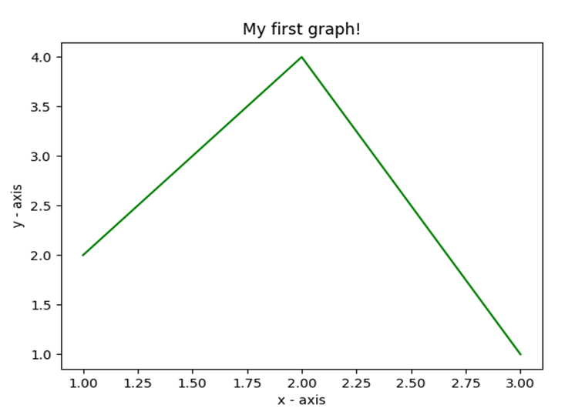
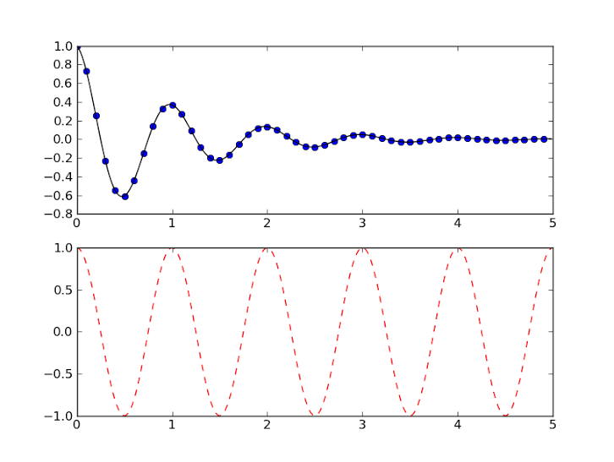
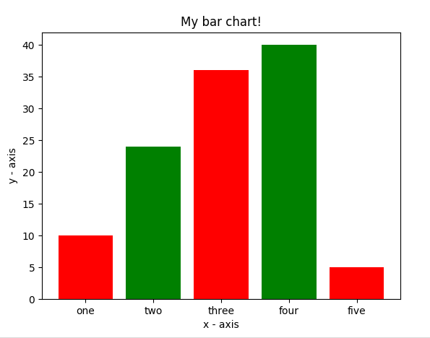
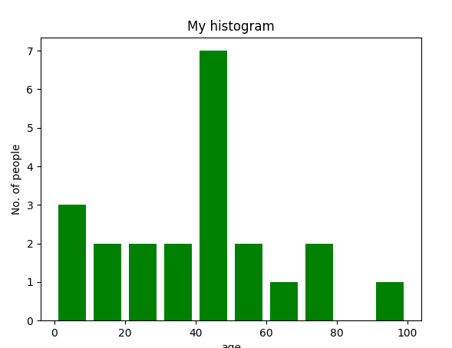
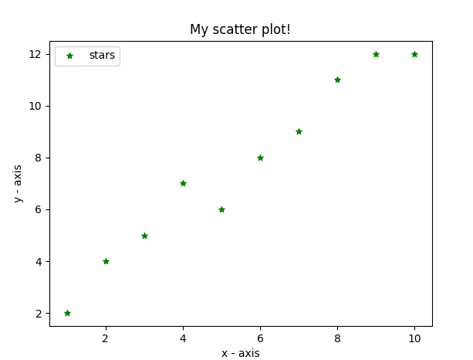
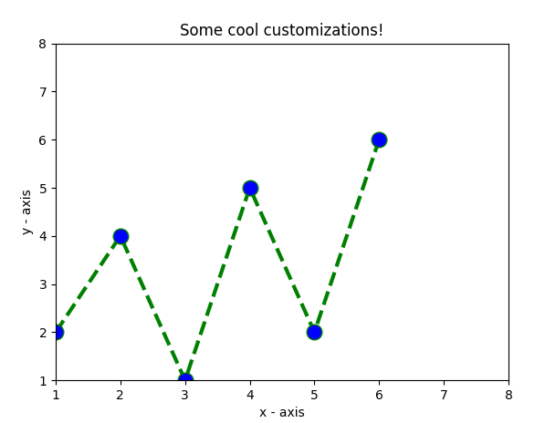
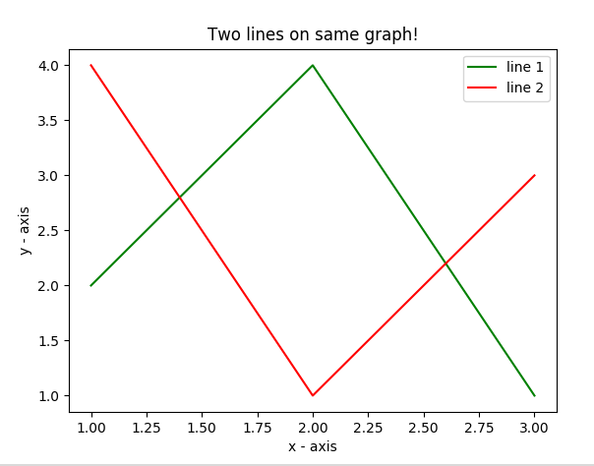
Matplotlib
Matplotlib allows you to make easy things
You can generate plots, histograms, power spectra, bar charts, errorcharts, scatterplots, etc., with just a few lines of code.

Slide 7
What is Data Visualization?
Data visualization is the practice of translating data into visual contexts, such as a map or graph, to make data easier for the human brain to understand and to draw comprehension from. The main goal of data viewing is to make it easier to identify patterns, styles, and vendors in large data sets.
Data visualization tools provide a way to present these figures and graphs.
Often, it is essential to analyze massive amounts of information and make data-driven decisions.
  converting complex data into an easy to understand representation

Slide 8
Data visualization formats
1. Bar Charts
2. Histograms
3. Pie charts
4. Scatter Plot
5. Area Plot
6. Heat Maps
7. Line Plot

Slide 9
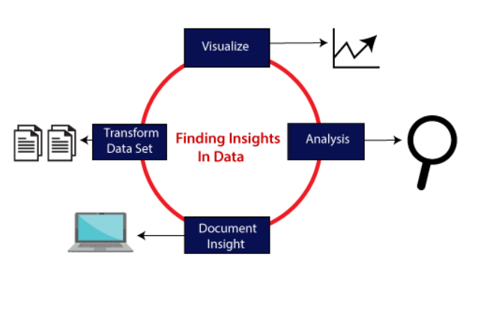
There are five phases which are essential to make the decision for the organization:

Slide 10
Visualize: We analyze the raw data, which means it makes complex data more accessible, understandable, and more usable. Tabular data representation is used where the user will look up a specific measurement, while the chart of several types is used to show patterns or relationships in the data for one or more variables.
Analysis: Data analysis is defined as cleaning, inspecting, transforming, and modeling data to derive useful information. Whenever we make a decision for the business or in daily life, is by past experience. What will happen to choose a particular decision, it is nothing but analyzing our past. That may be affected in the future, so the proper analysis is necessary for better decisions for any business or organization.
Document Insight: Document insight is the process where the useful data or information is organized in the document in the standard format.
Transform Data Set: Standard data is used to make the decision more effectively.

Slide 11
Data Visualization in Python using Matplotlib
Matplotlib is the most basic library built on numpy array for viewing information about drawings.
Matplotlib Architecture
There are three different layers in the architecture of the matplotlib which are the following:
Backend Layer
Artist layer
Scripting layer
Backend layer
The backend layer is the bottom layer of the figure, which consists of the implementation of the various functions that are necessary for plotting. There are three essential classes from the backend layer FigureCanvas(The surface on which the figure will be drawn), Renderer(The class that takes care of the drawing on the surface), and Event(It handle the mouse and keyboard events).
Artist Layer
The artist layer is the second layer in the architecture. It is responsible for the various plotting functions, like axis, which coordinates on how to use the renderer on the figure canvas.
Scripting layer
The scripting layer is the topmost layer on which most of our code will run. The methods in the scripting layer, almost automatically take care of the other layers, and all we need to care about is the current state (figure & subplot).

Slide 12
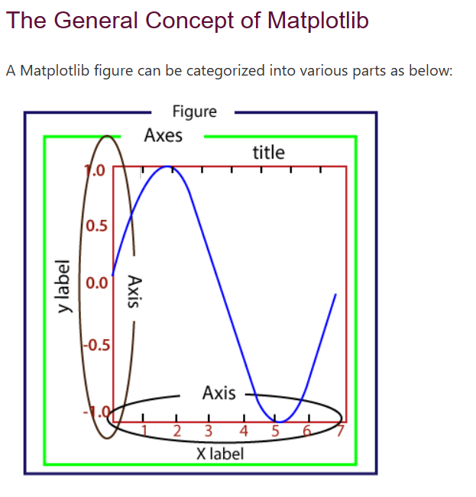
Figure: It is a whole figure which may hold one or more axes (plots). We can think of a Figure as a canvas that holds plots.
Axes: A Figure can contain several Axes. It consists of two or three (in the case of 3D) Axis objects. Each Axes is comprised of a title, an x-label, and a y-label.
Axis: Axises are the number of line like objects and responsible for generating the graph limits.
Artist: An artist is the all which we see on the graph like Text objects, Line2D objects, and collection objects. Most Artists are tied to Axes.

Slide 13
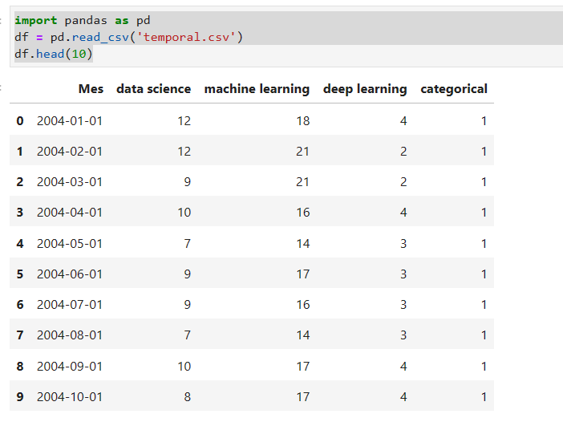
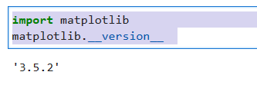
Matplotlib charts are made up of two main elements, axes (lines separating the chart area) and a number (where we draw the X-axis and Y-axis). Now let’s build the simplest graph:

Slide 14
pyplot
text() : adds text in an arbitrary location
xlabel(): adds text to the x-axis
ylabel(): adds text to the y-axis
title() : adds title to the plot
clear() : removes all plots from the axes.
savefig(): saves your figure to a file
legend() : shows a legend on the plot
All methods are available on pyplot and on the axes instance generally.

Slide 15
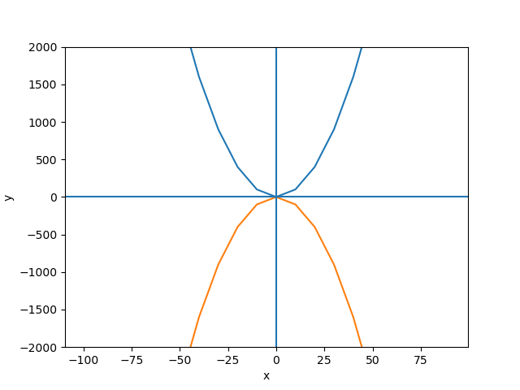
import matplotlib.pyplot as plt
y1 =[]
y2 =[]
x = range(-100,100,10)
for i in x: y1.append(i**2)
for i in x: y2.append(-i**2)
plt.plot(x, y1)
plt.plot(x, y2)
plt.xlabel("x")
plt.ylabel("y")
plt.ylim(-2000, 2000)
plt.axhline(0) # horizontal line
plt.axvline(0) # vertical line
plt.savefig("quad.png")
plt.show()
Incrementally modify the figure.
Save your figure to a file
Show it on the screen

Slide 16
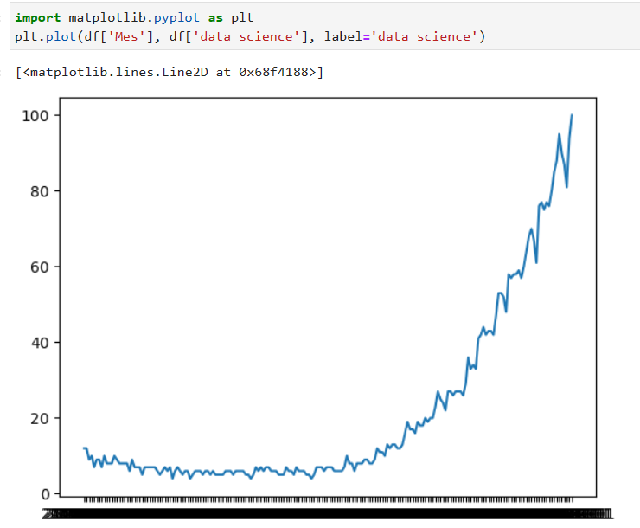
Pyplot is a state-based interface to a Matplotlib module which provides a MATLAB-like interface.

Slide 17
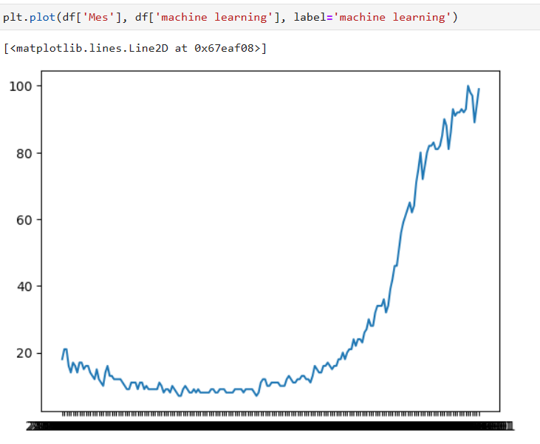

Slide 18
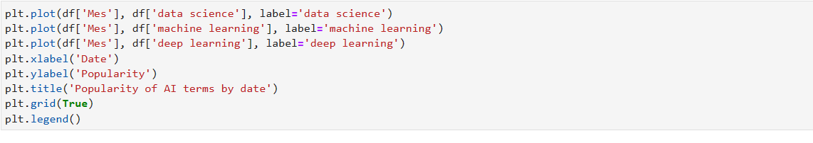
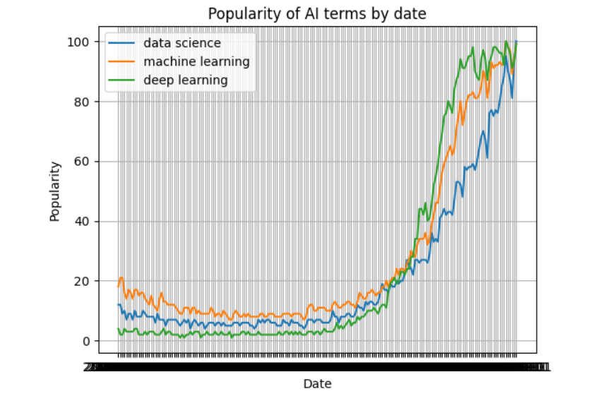

Slide 19
It is possible, to define explicit limits by using the following methods:
By using xlim() and ylim()
By using set_xlim() and set_ylim()
By using axis()
In matplotlib, to set or get X-axis and Y-axis limits, use xlim() and ylim() methods, accordingly. These methods define the limits for respective axes if arguments are passed, and if no arguments are passed, we obtain a range of the respective axes.
Syntax:
# Set x-axis range
matplotlib.pyplot.xlim()
# Set y-axis range
matplotlib.pyplot.ylim()

Slide 20
REFERENCES FOR FURTHER LEARNING OF THE SESSION
Text Books:
Introduction to Data Science- A Structured Methodology,Goran trajkovski.
Data Science from Scratch- Joel Grus - O’Reilly - 2015
Practical Statistics for Data Scientists - Peter Bruce, Andrew Bruce & Peter Gedeck - O’Reilly - 2020
Data Science and Machine Learning (Mathematical and Statistical Methods) - Dirk P. Kroese, Zdravko I. Botev, Thomas Taimre, Radislav Vaisman- Chapman and Hall/CRC - 2025
Foundations of Data Science - Avrim Blum, John Hopcroft, and Ravindran Kannan - Cambridge University Press – 2020
Reference Books:
R1.Data Science and Its Applications by Aakanksha Sharaff and G. R. Sinha.
R2. Introducing Data Science Big Data, Machine Learning, and more using Python tools. by Davy cielen, Arno D.B. Meysman and Mohamed Ali.

Slide 21

THANK YOU
Team – DS

